Slide 1
Retirement Income:
IRAs and Pensions
Pub 4491 – Lesson 12
Pub 4012 – Tab D
Notes:
1
This Lesson is divided into three main sections: information that applies to all retirement income, provisions that apply to IRAs, and provisions that apply to employer-sponsored (pensions) distributions.
Quality Review is included at the end.
Students should be asked to look up material in Pub 4012 when it is referenced so they become accustomed to it
TaxSlayer has made significant enhancements to the retirement income section – refer to Pub 4012 for entries
Class can be encouraged to play with TaxSlayer input to see what happens when codes are changed, single vs joint/survivor in simplified method is changed, etc.
At the end of each section are topics identified as Comprehensive. All counselors should be aware of these topics while experienced counselors should have a good working knowledge of them.

Slide 2
Objectives
Review provisions that apply to all retirement distributions
Review provisions that apply to IRAs
Review provisions that apply to employer-sponsored retirement plans

Slide 3
Types of Retirement Income
Individual Retirement Arrangement (IRA) Distributions
Pensions (used to describe all employer plans)
Annuities (treated as a pension)
Note: Social Security is covered in a separate lesson
We’ll go over similarities, then differences
Notes:
Several types of IRAs – will discuss in detail
Pension: Series of determinable payments made to employee (or survivor) after retirement from work
Annuity: Payments under contract from insurance company, trust company or individual

Slide 4
Distributions
a.k.a. taxable income, maybe
Notes:
4

Slide 5
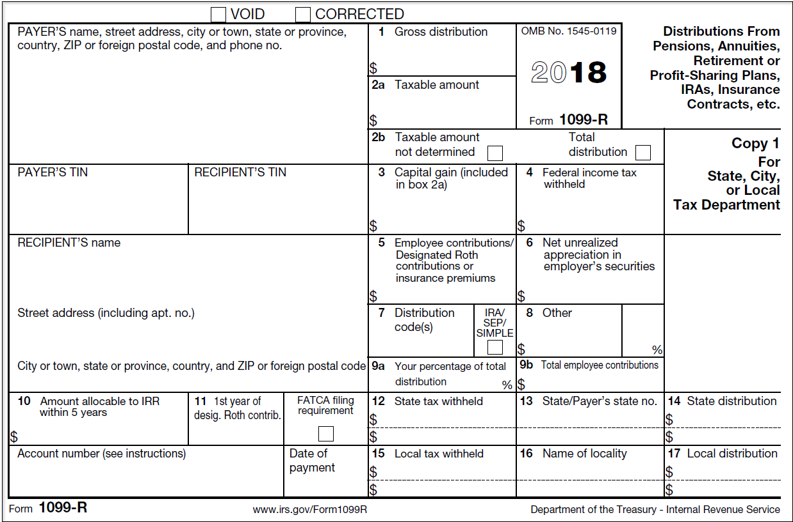
Form 1099-R Data Entry
Indicates
IRA when checked
Notes:
Start with basics: SSN, Year of form, Name, Codes – these are critical!
Box 1 – Gross distribution
Box 2a – Taxable amount – NOTE: If taxable amount is determined no further action is needed to determine taxable amount
Box 2b - If Taxable amount not determined is checked, Simplified General Rule calculation will be required.
Box 9b indicates employee contribution which will be used in the Simplified General Rule if taxable amount is not included in box 2a.
If box 2a is zero (not just blank), the distribution is non taxable . Correct Box 2a to read zero.)
Box 7 – Distribution code covered in one of next charts
Boxes 4 and 12 – Federal and State Income tax withheld
Box 7 – Checked if IRA

Slide 6
Form 1099-R
Must have correct SSN on form
  If not correct – taxpayer needs a corrected Form 1099-R
If ITIN return, e-file return in normal manner
  If ITIN return and cannot get a 1099-R with the ITIN, need to paper file the return (cannot be e-filed)

Slide 7
1099-R Box 7 Distribution Codes
Pub 4012 Tab D
More often seen:
7 | Normal distribution (most common)
1 | Early withdrawal, no known exception, 10% additional tax
2 | Early distribution, exception applies
3 | Disability
4 | Death
G | Rollover not taxable, no additional tax applies
Notes:
Generally, codes are listed on the back of Form 1099-R.

Slide 8
1099-R Box 7 Distribution Codes
Pub 4012 Tab D
Less common codes:
S | Early distribution from a SIMPLE IRA in the first 2 years, no known exception
F | Charitable gift annuity
Q | Qualified distribution from a Roth IRA
B | Designated Roth account distribution
H | Rollover from designated Roth to Roth IRA
U | Dividends distributed from an ESOP under section 404 (k)
Notes:
If see a code that Counselor is not familiar with, look it up in P4012
If still not comfortable, ask for assistance, including referring the return to another more experienced counselor

Slide 9
1099-R Box 7 In-Scope Distribution Codes
Pub 4012 Tab D
Codes in scope for Tax-Aide:
6 | Tax-free Section 1035 exchange (distribution is not taxable)
W | Payments for purchasing qualified long-term care insurance contracts under combined arrangements (distribution nontaxable and LTC payment not deductible (report on return)

Slide 10
1099-R Box 7 Out of Scope Distribution Codes
Pub 4012 Tab D
J or T | If {Roth} distribution is wholly or partially taxable or first time homebuyer exception applies If wholly nontaxable, remains in scope (see later)
D | If the net investment income tax applies
 | All other codes – see Scope Manual
Always refer to Tax-Aide Scope Manual
Notes:
Refer to current Scope Manual found in the Portal Library
Net investment income tax (NIIT) applies when AGI is more than $200,000 so rarely is this an issue

Slide 11
Box 7 Distribution Codes
Possible double letter codes
  Look up each letter or number
  Example: G4 – rollover (G) distribution to beneficiary upon death (4) of account holder

Slide 12
Intake and Interview
Pub 4012 Tab D
SYNC the 1099-R forms during the interview:
  S = Social
  Y = Year
  N = Name
  C = Codes in box 7
Know what needs to be done before entering data
Notes:
Confirm the SSN / ITIN is correct
Make sure it’s the correct year
Double check the name – may say “inherited”
Most important – check the codes
If you see a code you’re not familiar with, all codes can be found in Volunteer Resource Guide Pub 4012 Tab D

Slide 13
Taxable Distribution Computed
Payer computes and reports taxable portion of distribution in Box 2a on Form 1099-R
Enter data as reported

Slide 14
Taxable Distributions
Retirement plans are funded by either before-tax or after-tax contributions
  Before-tax – entire distribution will be fully taxable
  After-tax – distributions partially taxable (box 9b Form 1099-R)
“Taxable amount not determined” normally checked
Notes:
If taxpayer says that they have been using the General Rule, send them to a paid preparer.
Simplified General Rule is IN SCOPE while General Rule is OUT OF SCOPE

Slide 15
Partly Taxable Distributions
Traditional or SEP IRA
  Use Form 8606 to figure taxable portion
Pension (not IRA)
  Use Simplified Method
Both allow the taxpayer to recover their “cost” over the term of distributions
Notes:
Simplified Method may also be called the Simplified General Rule.
If taxpayer says that they have been using the General Rule, send them to a paid preparer.

Slide 16
Transfers
Can move IRA from one trustee to another
  No change in type of IRA (traditional vs Roth)
  This is a transfer
    no limit on number of transfers
  Trustee may or may not issue a 1099-R form
  If they do, should be code G
Wholly nontaxable – enter -0- in Box 2a

Slide 17
Rollovers
Can move retirement savings from one qualified account to a different one: 401(k), IRA, etc.
  Direct rollover
    From one qualified trust to another (no money out)
    Reported as code G not taxable
  Self rollover
    Taxpayer receives funds and redeposits in qualified account within 60 days
    Reported on 1099-R with taxable code
    IRA self rollover limited to one in a 12-month period
Notes:
The 12 month period spans across year end
More info can be found in IRS Pubs 590-B for IRAs and Pub 575 or Pub 721 for pensions
Note: an RMD cannot be rolled over

Slide 18
Rollovers
Confirm box 2a has the taxable portion (can be $0)
Indicate rollover was made
  Mark “rollover” and indicate the amount rolled
  TaxSlayer prints “rollover” on Form 1040 Line 4a
Any portion of distribution not rolled is taxable
  reduced if basis in plan

Slide 19
Distributions – Comprehensive Topic
Self-certification Exception to Rollover 60-day rule

Slide 20
Rollovers: 60-Day Limit Exception
Pub 4012 Tab D
If taxpayer misses 60-day window, can self-certify that met requirements for waiver if
  Presents letter to financial institution receiving late rollover contribution
  Rollover satisfies all other requirements (except 60-day requirement)
  Can show that one or more reasons listed in Model Letter prevented taxpayer from completing timely rollover
  IRS not previously denied a waiver request
  Rollover made as so a practicable (usually within 30 days) after reasons for delay no longer prevent taxpayer from making contribution
Notes:
Find instructions in P4012.
IRS may audit your income tax return to verify that taxpayer qualified for a waiver.
Rollover made as soon as practicable (usually within 30 days) after reasons for delay no longer prevent taxpayer from making contribution
Rollover - Indirect transfer**
Written self-certification-Certification Model Letter in the Appendix of Rev. Proc. 2016-47 Waiver of 60-Day Rollover Requirement Section 3.
Eleven Conditions for self-certification
Error committed by the financial institution…
Distribution, in form of check, was misplaced or never cashed
Distribution deposited into and remained in account mistakenly thought to be an eligible retirement plan
TP’s principal resident was severely damaged
Member of TP’s family died
TP or a member of the TP’s family was seriously ill
TP was incarcerated
Restrictions were imposed by a foreign country
Postal error occurred
Distribution made on account of a levy under §§6331 and proceeds of levy have been returned to the TP
Party making distribution to which rollover relates delayed providing information that the receiving plan or IRA required to complete the rollover despite the TP’s reasonable efforts to obtain the information

Slide 21
Rollovers: 60-Day Limit Exception (cont.)
It’s up to the taxpayer to complete the self-certification
Financial institution not required to accept self-certification
IRS requires IRA trustee complete Form 5498 when accepting delayed rollover contribution

Slide 22
Provisions that apply to IRA Distributions
Notes:
22

Slide 23
Types of IRAs
Traditional, including
  Savings Incentive Match Plans for Employees (SIMPLE)
  Simplified Employee Pension (SEP)
Roth
Notes:
Traditional IRA
typically, fully deducted when contribution was made and therefor distribution is fully taxable
If not, need form 8606 Part I – look at prior year
SIMPLE/SEP A variation of a traditional IRA that may be partly or wholly funded by an employer
Typically, fully taxable when distributed
Roth
Not deductible when contribution is made
Not taxable when distributed – IF rules are followed

Slide 24
Required Distributions or Additional Tax Assessed
Too early: wait until age 59½ to take a distribution
Too late: start distributions when 70½
Too little: take required minimum distribution
Too much: contribution is limited (see Adjustments to Income lesson)
Additional tax covered in the Other Taxes lesson

Slide 25
Traditional IRA Required Minimum Distributions
Pub 4012 Tab H
IRA trustees compute the Required Minimum Distribution (RMD) for traditional IRAs
Remind taxpayers when approaching age 70
Confirm taxpayers with traditional IRAs have taken RMD
Company plans have rules, too, that they administer
Notes:
The IRA owner can have multiple IRAs at various financial institutions or brokerages.
At the taxpayer’s choice:
The RMD is computed on the total of all IRAs and can be withdrawn from any IRA or IRAs.
Alternatively, the RMD can be computed for each IRA and withdrawn from that IRA.

Slide 26
IRA – Taxable Amount – Roth IRA
A Roth contribution was never deducted
  after-tax contribution
Qualified distributions not taxable
  At least 5 years since initial ROTH contribution
  Over age 59½
Code Q on 1099-R (but may be J or T)
If rules not met, out of scope
Notes:
Since contributions were never deducted, taxpayers have basis in their Roth IRAs.
That basis is taken into account when the distribution does not qualify for full tax-free treatment – which is out of scope.

Slide 27
IRA – Taxable Amount – Roth IRA
1099-R code J or T
  Trustee may not know whether rules met
We confirm whether taxpayer met rules
If rules met, none is taxable (enter -0- in box 2a)
  If code J, also use Form 5329 code 12 to remove the additional tax (see Other Taxes lesson)
If rules not met, out of scope

Slide 28
IRA – Taxable Amount – Traditional IRA
Most often, contributions fully deducted
  Distribution fully taxable
If contributions not fully deducted, taxpayer has basis in IRA
  Form 8606 used to track IRA basis – copy in prior year return
  Form 8606 used to compute taxable percentage of current distribution
Even if no current year distribution, complete 8606 if used in prior year to track basis
Notes:
When an employee rolls over their 401(k) from an employer plan to a traditional IRA, they can roll amounts attributable to pre-tax contributions only
So, IRAs started from an employer plan rollover would not have basis
No Form 8606 filed when contributions not fully deductable – taxpayer looses basis in IRA and IRA becomes fully taxable

Slide 29
Traditional IRA – Form 8606 Rules
Aggregate all the taxpayer’s own traditional IRAs
Do not aggregate inherited IRA or Roth IRA
Basis recovered on each year’s distributions as a percentage of the value of IRAs
  See Form 8606, Part I
  Use basis info from prior year’s 8606

Slide 30
Inherited IRAs
Pub 590-B
Basis tracked separately for each inherited IRA
Usually, must take distributions over 5-year period
  Depends on IRA status on date account holder died
Spouses have special rules
Rely on taxpayer to satisfy distribution requirements
May need more than one Form 8606 if taxpayer’s IRA has basis and they inherit another IRA with basis
Notes:
If the IRA is in payout mode when the account holder dies, the nonspousal beneficiary can take distributions over the longer of their life or the life expectancy of the decedent.
A spouse can keep the IRA as inherited to make it their own. If they make it their own, then it would be aggregated with the survivor’s other IRAs.

Slide 31
IRA Distributions – Comprehensive Topics
IRA Conversions
Qualified Charitable Distribution
HSA Funding Distributions
Loss on investments at termination

Slide 32
IRA Conversions
Traditional to Roth conversion
  No penalty at any age
  Cannot convert required minimum distribution (RMD)
Complete Form 8606, Part II
  Indicate amount converted in TaxSlayer
Complete Form 8606, Part I if IRA has basis
Conversions can no longer be undone (recharacterized)
Notes:
Law change
– can recharacterize an IRA contribution (new money) from traditional to Roth or vice versa
-- cannot recharacterize a Roth conversion

Slide 33
Traditional IRA – Qualified Charitable Distribution
Qualified charitable distribution (QCD) done correctly
  Distribution is not income
  No deduction for charitable contribution
  AGI not inflated for tax purposes or Medicare premiums
QCD counts towards the taxpayer’s required minimum distribution (RMD)

Slide 34
Traditional IRA – QCD Rules
Taxpayer must be at least 70½ when distribution made
QCD made directly from IRA trustee to charity
Taxpayer must have same type of acknowledgement of contribution needed to claim charitable contribution deduction
Maximum annual exclusion for a QCD is $100,000
On joint return, spouse can also have a QCD and exclude up to $100,000 (max total of $200,000)
Notes:
Qualified Charitable Distribution made permanent.

Slide 35
Traditional IRA – HSA* Funding Distribution
One-in-a-lifetime transfer from IRA to HSA
If done right:
  Distribution is not income
  No deduction for HSA contribution
  AGI is not inflated for tax purposes or for Medicare premiums
Out of scope (and extremely rare)
* Health Savings Account – optional certification available
Notes:
The maximum that may be transferred is the year’s limit on an HSA contribution.

Slide 36
Loss on Termination of Traditional IRA
IRA loss occurs when all amounts from all traditional IRAs have been distributed and left with unrecovered basis
Unable to claim the loss on Sch A Miscellaneous Deductions subject to 2% (suspended 2018-2025)
Check is state allows loss in 2018
Notes:
Schedule A Misc Deduction subject to 2% not allowed in 2018

Slide 37
Loss on Termination of Roth IRA
Loss occurs when all amounts from all Roth IRAs have been distributed and left with unrecovered basis
Unable to claim the loss on Sch A Miscellaneous Deductions subject to 2% (suspended 2018-2025)
Check if state allows loss in 2018
Note: there is no form that tracks Roth basis. It is up to the taxpayer to keep records
Notes:
Schedule A Misc Deduction subject to 2% not allowed in 2018

Slide 38
Provisions that apply to Pension Distributions
Notes:
38

Slide 39
Employer Retirement Plans
Employer retirement plan
  Trust is set up by the employer funded and administered according plan documents
Contributions can be
  By employer
  By employee (before or after tax)
  Both
Notes:
39

Slide 40
Employer Retirement Plan (cont.)
Distributions governed by plan document can be at:
  Retirement
  Disability (prior to retirement age)
  Death
  Separation of service, other than retirement
Trustee handles all distributions
Distributions reported on tax return
Notes:
40

Slide 41
Annuities
Pub 17 Ch 10
Annuities are payments under a tax-advantaged contract from insurance company, trust company or individual
Retirement plan can buy annuity for retiree
  Can be from an IRA
Annuity distributions usually fully taxable
If basis in annuity, portion not taxable
Notes:
41
Annuities can build value tax-deferred. That is, tax are due when distributions are actually made.
If there is basis and the general rule is or must be used, the return is out of scope

Slide 42
Pension Distributions
“Pension distributions” refer to employer plan and annuity distributions
  To differentiate from IRA distributions
Notes:
42

Slide 43
Intake and Interview
Form 1099-R IRA box not checked:
  Taxable amount provided input as reported
  Taxable amount is not provided (Box 2a is blank) check for employee contribution
    Use simplified method to calculate taxable amount
Special rules for disability pensions and other special cases discussed later

Slide 44
Simplified Method
Simplified method calculation requires
  Gross distribution amount
  Cost in plan (total contributions)
  Annuity start date – refer to last year’s return and use a good interview
  Single-life or multiple-life annuity (aka joint/survivor)
Notes:
If the starting date of the payments was prior to July 2, 1986, the taxpayer used either the General Rule (which is out of scope) or the “Three Year Rule”. If the latter, the entire amount of the taxpayer’s contribution would have been recovered by now and the entire amount of the payment received this year should be entered in box 2 on the Form 1099-R as taxable. (The “Three Year Rule” was repealed for annuities starting after July 1, 1986.)
If the starting date of the payments was after July 2, 1986, but before January 1, 1987, the annual exclusion continues even after all contributions have been exhausted – for the taxpayer and (if a joint annuity) the spouse, for the rest of their lives.
If the starting date of the payments was after 1986 and before November 19, 1996, the taxpayer had a choice of using the General Rule or the Simplified Method (with some restrictions) and then sticking with that choice. Alternately, the Simplified Method is referred to as the Simplified General Rule. Both are In Scope.

Slide 45
Simplified Method
Additional information required
  Age – Annuitant’s age on date annuity began*
    Spouse’s age if joint/survivor annuity is selected
    Note if annuity starting date is before or after taxpayer’s birthday for that year
  Amounts previously recovered
  Number of months paid in previous years
  * If taxpayer did not start receiving annuity before death then spouse’s age when started drawing the annuity is used
Notes:
If the starting date of the payments was prior to July 2, 1986, the taxpayer used either the General Rule (which is out of scope) or the “Three Year Rule”. If the latter, the entire amount of the taxpayer’s contribution would have been recovered by now and the entire amount of the payment received this year should be entered in box 2 on the Form 1099-R as taxable. (The “Three Year Rule” was repealed for annuities starting after July 1, 1986.)
If the starting date of the payments was after July 2, 1986, but before January 1, 1987, the annual exclusion continues even after all contributions have been exhausted – for the taxpayer and (if a joint annuity) the spouse, for the rest of their lives.
If the starting date of the payments was after 1986 and before November 19, 1996, the taxpayer had a choice of using the General Rule or the Simplified Method (with some restrictions) and then sticking with that choice. Alternately, the Simplified Method is referred to as the Simplified General Rule. Both are In Scope.

Slide 46
Calculating Taxable Amount
TaxSlayer calculator
  may carryforward information following year
Bogart Pension Calculator
  http://tools.cotaxaide.org
  Enter the taxable amount from completed Bogart as 1099-R taxable amount in box 2b
  Print out and include with taxpayer return
Notes:
To be determined – TaxSlayer enhancements
Recommend Bogart for new taxpayers to help with the date arithmetic of determining age at start of annuity

Slide 47
Basis Recovery
Pub 4012 Tab D Simplified Method
Pension fully taxable after basis completely recovered
Except: annuitants who retired between July 2, 1986 and December 31, 1986
  Taxable amount permanently reduced

Slide 48
Additional Tax on Pensions
Premature distributions – same rules and penalties as IRAs … but exceptions my differ
  See Other Taxes lesson

Slide 49
Pension Distribution Forms
1099-R – company plans/annuities
And variations
  RRB-1099-R – (green) railroad benefit
  CSA-1099-R – civil service, government
  CSF 1099-R – survivor annuity paid (civil service retirement payments)
  Format is different and there a few nuances
Notes:
More info:
Pensions – Pub 575
Civil service retirement benefits – Pub 721

Slide 50
1099-R
Notes:
Start with basics: SSN, Year of form, Name, Codes – these are critical!
Box 1 – Gross distribution
Box 2a – Taxable amount – NOTE: If taxable amount is determined no further action is needed to determine taxable amount
Box 2b - If Taxable amount not determined is checked, Simplified General Rule calculation will be required.
Box 9b indicates employee contribution which will be used in the Simplified General Rule if taxable amount is not included in box 2a.
If box 2a is zero (not just blank), the distribution is non taxable . Correct Box 2a to read zero.)
Box 7 – Distribution code covered in one of next charts
Boxes 4 and 12 – Federal and State Income tax withheld
Box 7 – Checked if IRA

Slide 51
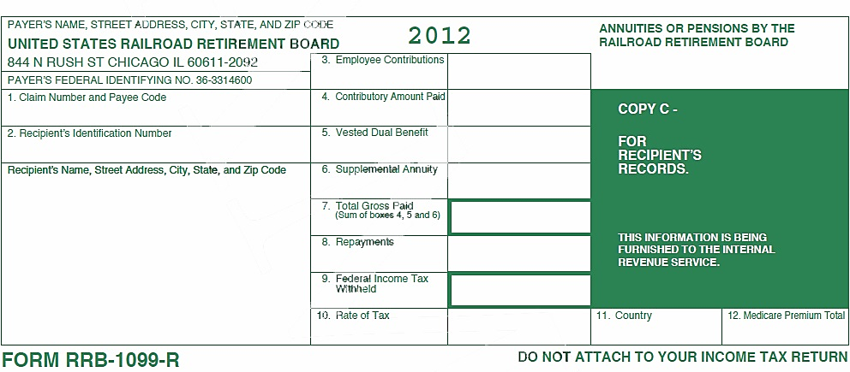
Railroad Retirement RRB-1099-R – Tier 2 Benefits Green
2018
12,345
Enter all data as it appears on the form
It is not necessary to move data to other boxes
1,089.16
-0-
-0-
354.00
Notes:
Click 1 – Total Gross Paid
Click 2 – Federal Income Tax withheld
Click 3 – Employee Contribution. Use Bogart calculator to determine taxable portion of Tier 2 benefits.
Click 4 – Medicare Premium that needs to be added to Schedule A
See Pub 4012 for directions for entering information. Distribution code is generally 7

Slide 52
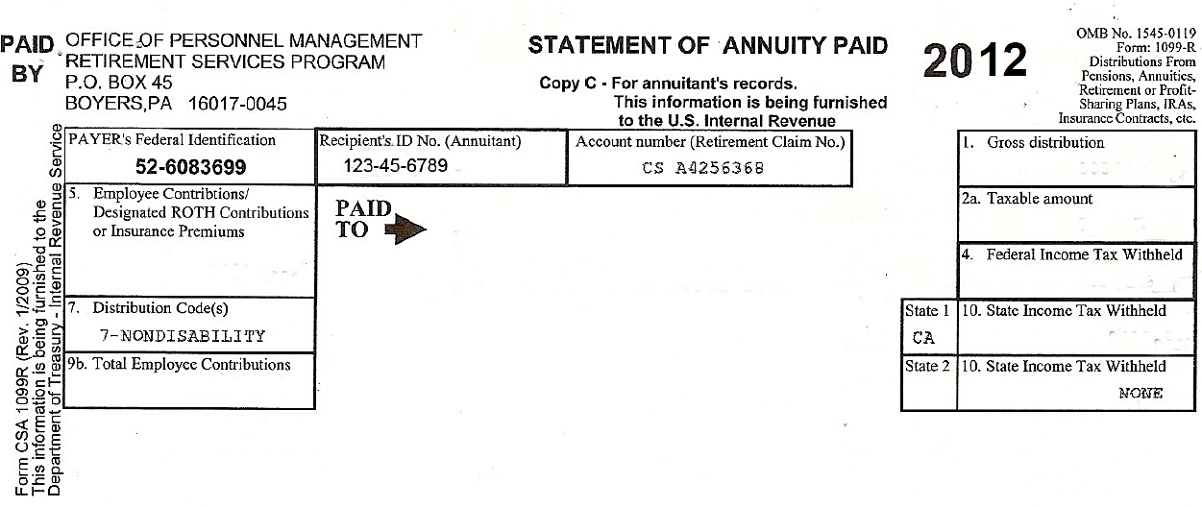
CSA 1099-R
20XX
2018
2016
Notes:
Box 1 – Gross distribution
Box 2 – Taxable amount
Box 7 – Distribution code
Boxes 4 and 10– Federal and State Income Tax withheld
Box 9b – Total employee contribution to be used in Simplified General Rule
Box 5 – Amount entered here is generally health insurance premium but may represent or include the difference between total distribution and the taxable distribution (basis recovery).ASK THE TAXPAYER!
If distribution in box 9b is pre 7/2/1986 the three year rule applies and amount cannot be used.

Slide 53
Special Case 1: Disability Pensions
Pub 4012 Tab D
Until taxpayer reaches employer plan’s minimum retirement age
  Disability pension reported and taxed as wages
  Eligible for Earned Income Credit
Once minimum retirement age reached, disability pension reported and taxed as pension
Disability pension reported as Code 3 Box 7 – confirm minimum retirement age of plan (civil service 1099 marked disability)
Taxpayer does not start to recover their basis until it is taxed as a pension
Notes:
Ask the taxpayer when minimum retirement age is for the plan.
State with Homestead may continue to tax the pension as disability. Check with your state!
*Even when the taxpayer reaches 65, some states continue to report the pension as a disability.

Slide 54
Special Case 1: Disability Pensions (cont.)
Railroad retirement (tier 2), minimum retirement age depends on years of service
  30 years of service or more, age 60
  Less than 30 years of service, age 62
Notes:
Ask the taxpayer when minimum retirement age is for the plan.
State with Homestead may continue to tax the pension as disability. Check with your state!
*Even when the taxpayer reaches 65, some states continue to report the pension as a disability.

Slide 55
Special Case 2: Civil Service Pensions
Box 5 is either health insurance charges or basis recovered this tax year (if taxable amount determined by payor)
  Ask if taxpayer can identify source
  Health or long-term-care insurance charges possible deductions
    Medical section of Schedule A or
    Self-employed health adjustment to gross income (if qualifies)
Notes:
Box 5 can also have the nontaxable portion of the distribution
Such as when the taxable amount is determined by the payer

Slide 56
Special case 3: Public Safety Officer
Pub 4012 Tab D
Public Safety Officers (PSO) health insurance premium may be deducted from pension
Up to $3,000 PSO insurance premium can be excluded from taxable amount
Reduce 1099-R box 2a by PSO insurance premium amount not to exceed $3,000
Health or long-term-care insurance charges over $3,000 possible deductions
  Medical section of Schedule A or
  Self-employed health adjustment to gross income (if it qualifies)
Notes:
Survivor benefits attributable to a Public Safety Officer who was killed in the line of duty before 1/1/97 are excludible for Federal
Must have retired from PSO position – no intervening jobs
Does not apply to survivor of PSO

Slide 57
Special Case 4: Zero Taxable
Box 1 has a gross distribution amount
Box 2a has -0- (not blank)
Box 2b not checked (taxable amount was determined)
Enter -0- in taxable distribution box 2a
Notes:
57

Slide 58
Pensions – Comprehensive Topics
Zero taxable 1099-R with amount in Box 5, Loss on Termination
Missing 1099-R
Hurricane Victims of 2017

Slide 59
Special Case 5: Lump-sum (total) distributions
Shown to right of Box 2 of Form 1099-R
If Box 7 code is A – May be eligible for 10-year tax option – Out of Scope

Slide 60
Special Case 5a: Loss on Termination
Box 1 has gross distribution amount, Box 2a may have -0-
Total distribution box checked
Box 5 has number equal to or larger than Box 1
Confirm underlying facts with taxpayer
  Cashed out an annuity
  Other termination of plan
Enter Box 1 amount and enter zero -0- in Box 2a
Notes:
60

Slide 61
Special Case 5a: Loss on Termination (cont.)
Pub 4012
May have a loss on annuity if “total distribution” (box checked) and box 5 is greater than box 1
Potential itemized deduction for unrecovered investment in the contract
  Not subject to 2% of AGI floor if due to death of annuitant
  Otherwise, subject to 2% of AGI floor for which no deduction tax years 2018 through 2025 (possible state deduction)
Notes:
61

Slide 62
Special Case 6: Missing 1099-R
Missing Form 1099-R
Taxpayer attempts failed to secure form from institution and IRS
Prepare substitute Form 4852
Need all information that appears on 1099-R
Taxpayer should retain copy of Form 4852
Amended return may be necessary if Form 1099-R received later and information differs
Notes:
62

Slide 63
Special Case 7: 2017 Hurricane Victims
Relief provided for plan loans and hardship distributions to an individual whose principal place of abode is located in the hurricane disaster area and who has sustained an economic loss by reason of Hurricane Harvey, Irma, or Maria
Provides an exception to the 10 percent early retirement plan withdrawal penalty for qualified hurricane relief distributions
Provides favorable repayment terms over 3 years, and allows taxpayers the option of spreading out income inclusion resulting from such withdrawals over a 3-year period.
These options require the completion of Form 8915-B, Qualified 2017 Disaster Retirement Plan Distributions and Repayments, and/or Form 8606, Nondeductible IRAs, and are out of scope

Slide 64
For All Retirement Distributions
Notes:
64

Slide 65
Quality Review
Check accuracy of input
  Verify EIN
  Verify federal and state withholding
Confirm any basis recovered correctly (Form 8606 or simplified method)
Review special cases
  Disability
  Civil service with health insurance
  PSO

Slide 66
Quality Review
Verify income correctly reported on Form 1040
  If IRA box checked on W-2 income reported on IRA line Form 1040
Verify no additional actions necessary
  Exception for early distribution
  Health insurance or LTC coverage deduction necessary

Slide 67
Exit Interview
Advise taxpayers approaching 70½ of RMD requirements
Review distribution rules if approaching 59½
Review withholding for next year
  W-4P
  W-4V for government payments

Slide 68
IRA and Pension Income
Questions…
Comments…

